Slide 1
All About Me
My Full name, Saurabh Kumar “Jha”
Joined Fidelity in mid of March
Living in Enfield, Connecticut
Served various role in industry like Automation Engineer/Lead, QA Lead/Manager, Automation Architect, Java Developer, SDET etc.

Slide 2
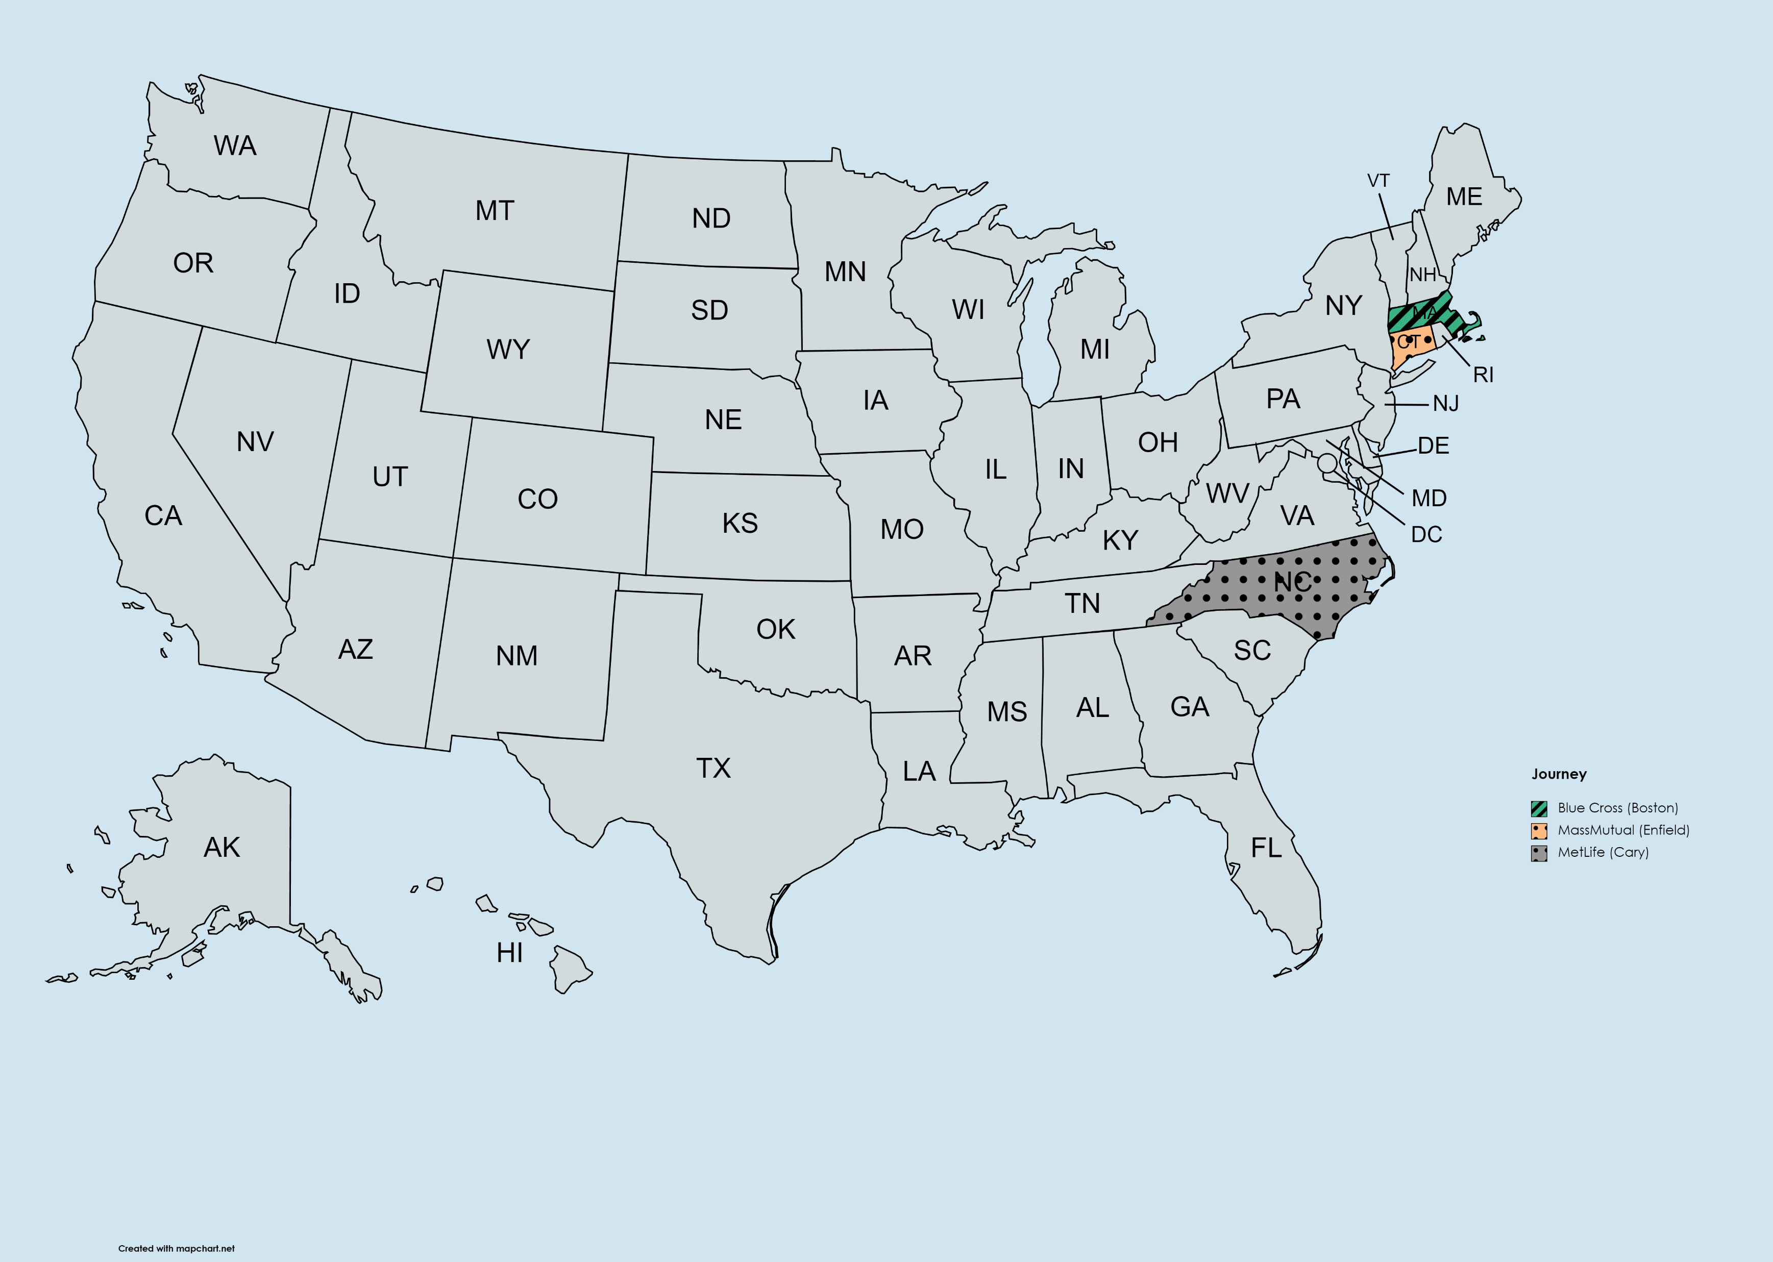
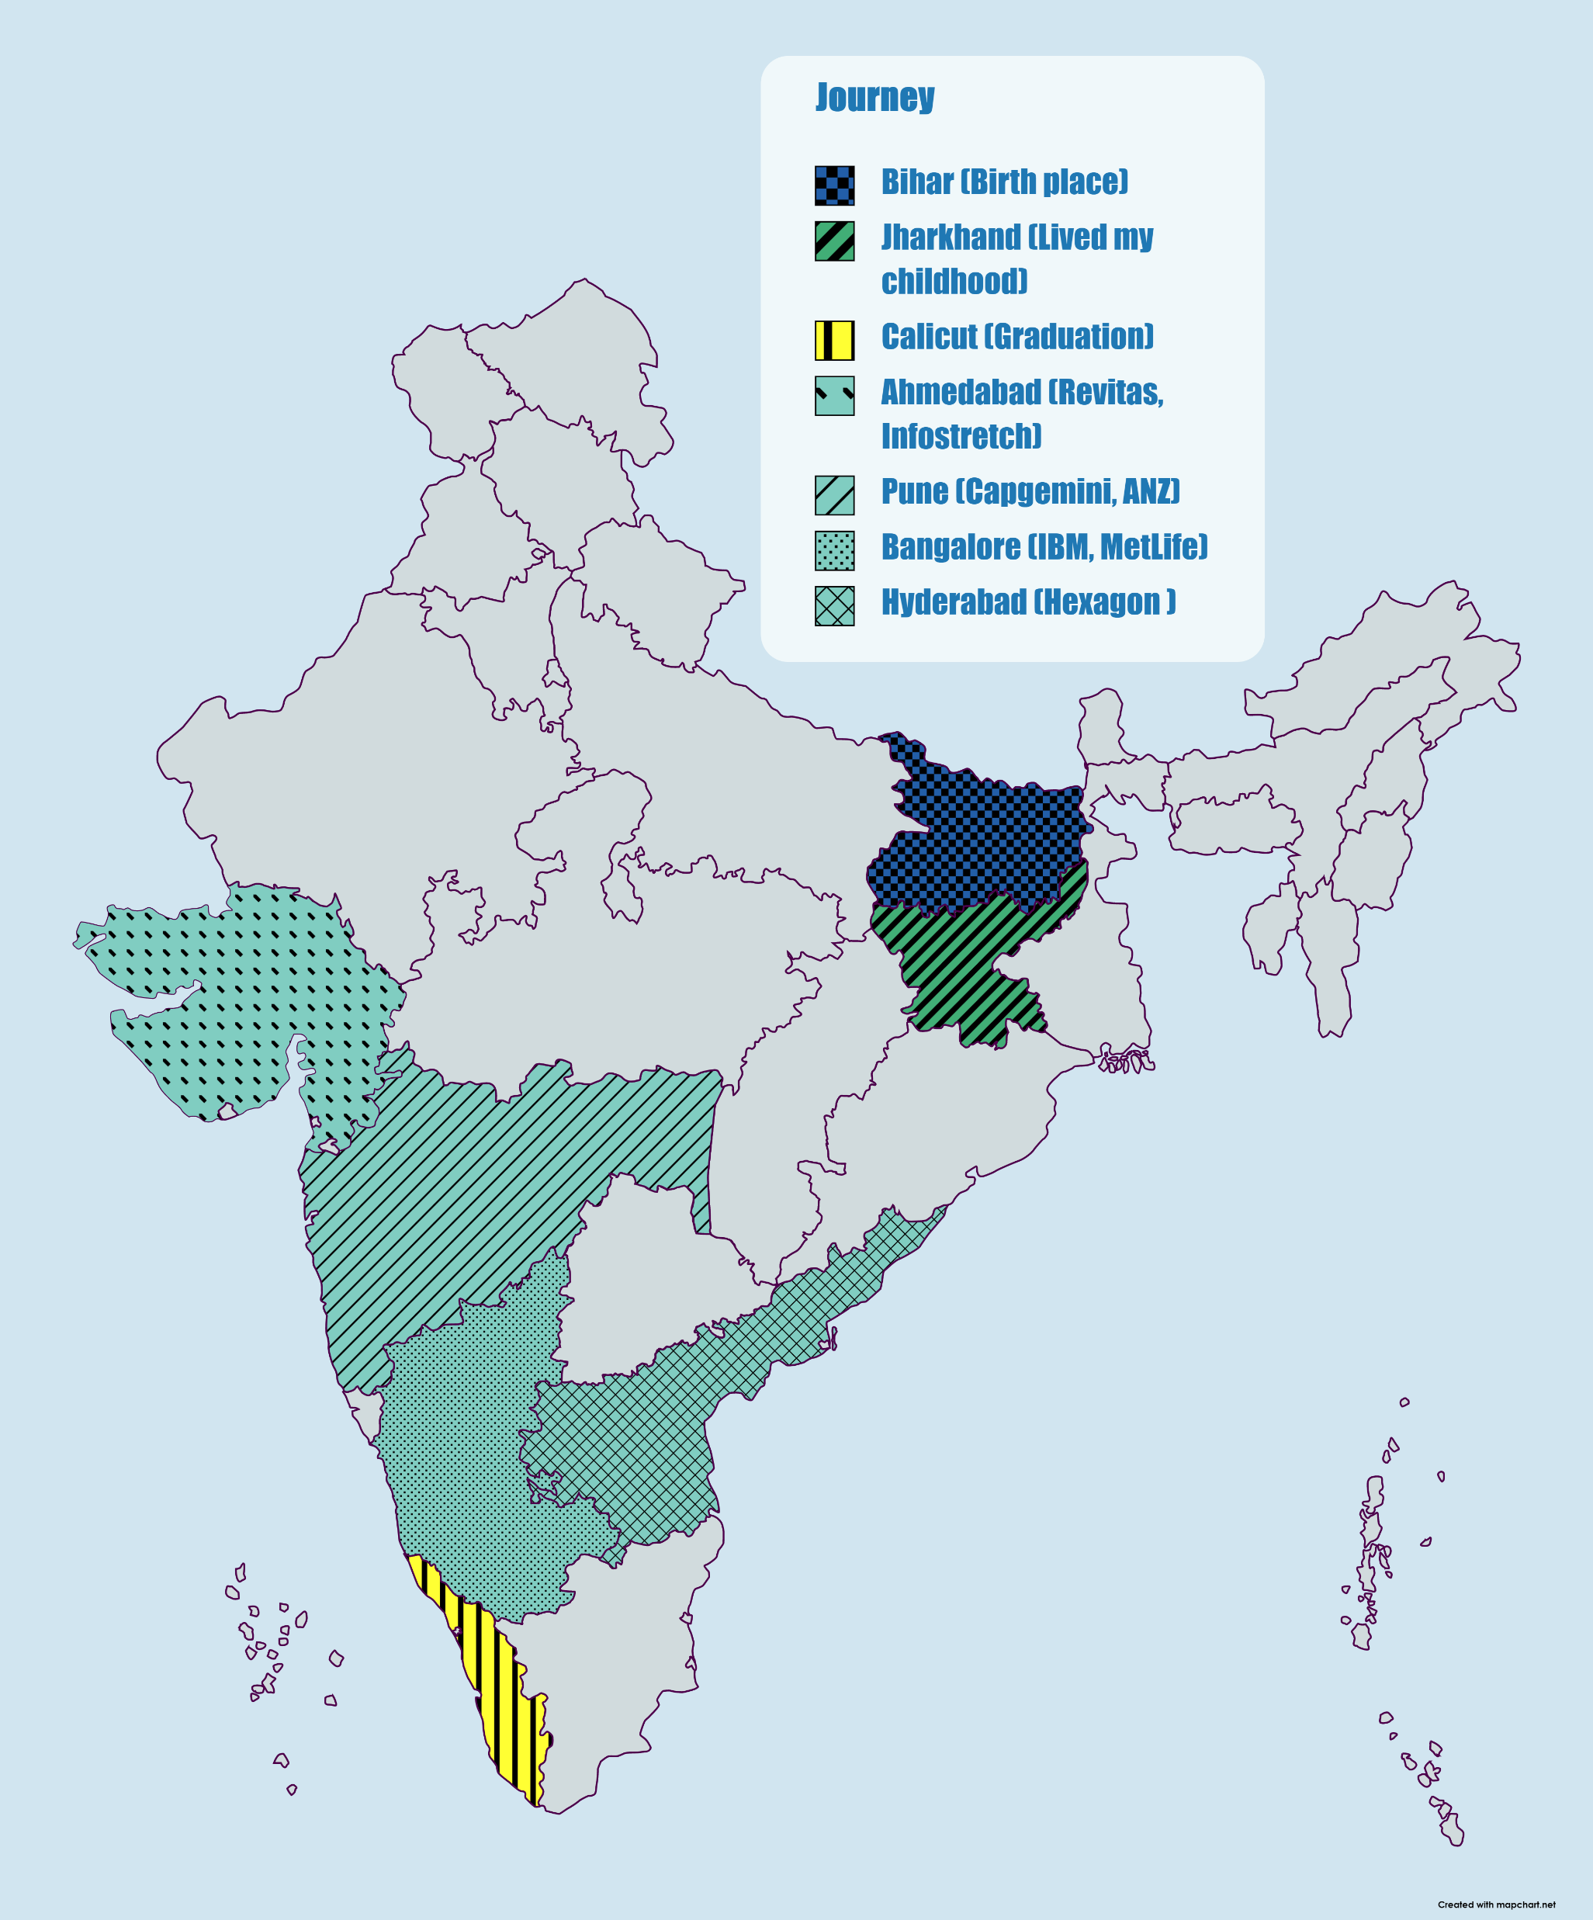
Land I covered
4
10
4

Slide 3
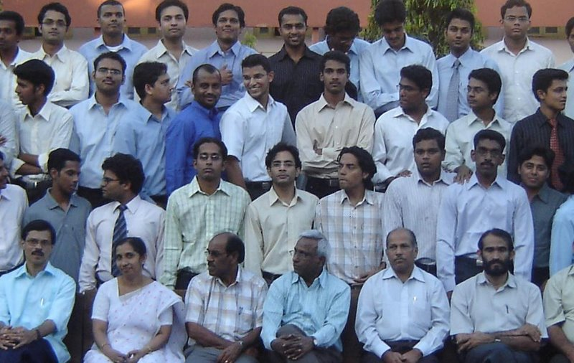
College class mate (We were 4 years together in class)

Slide 4
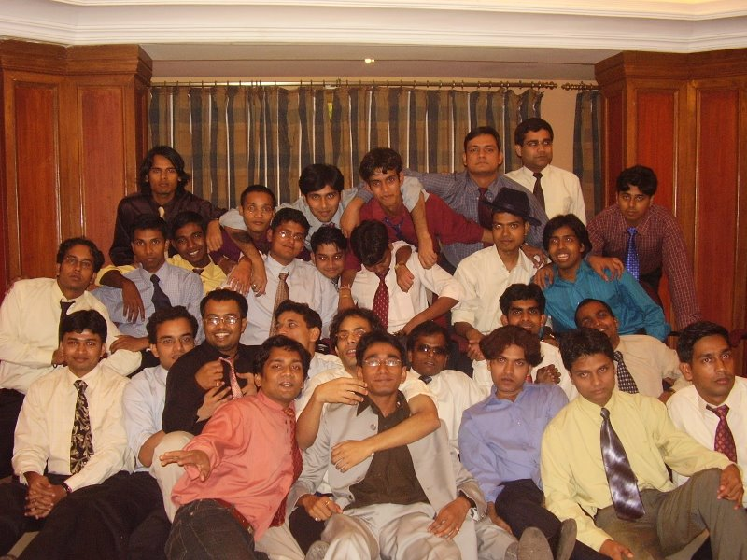
Best 4 years in college campus

Slide 5
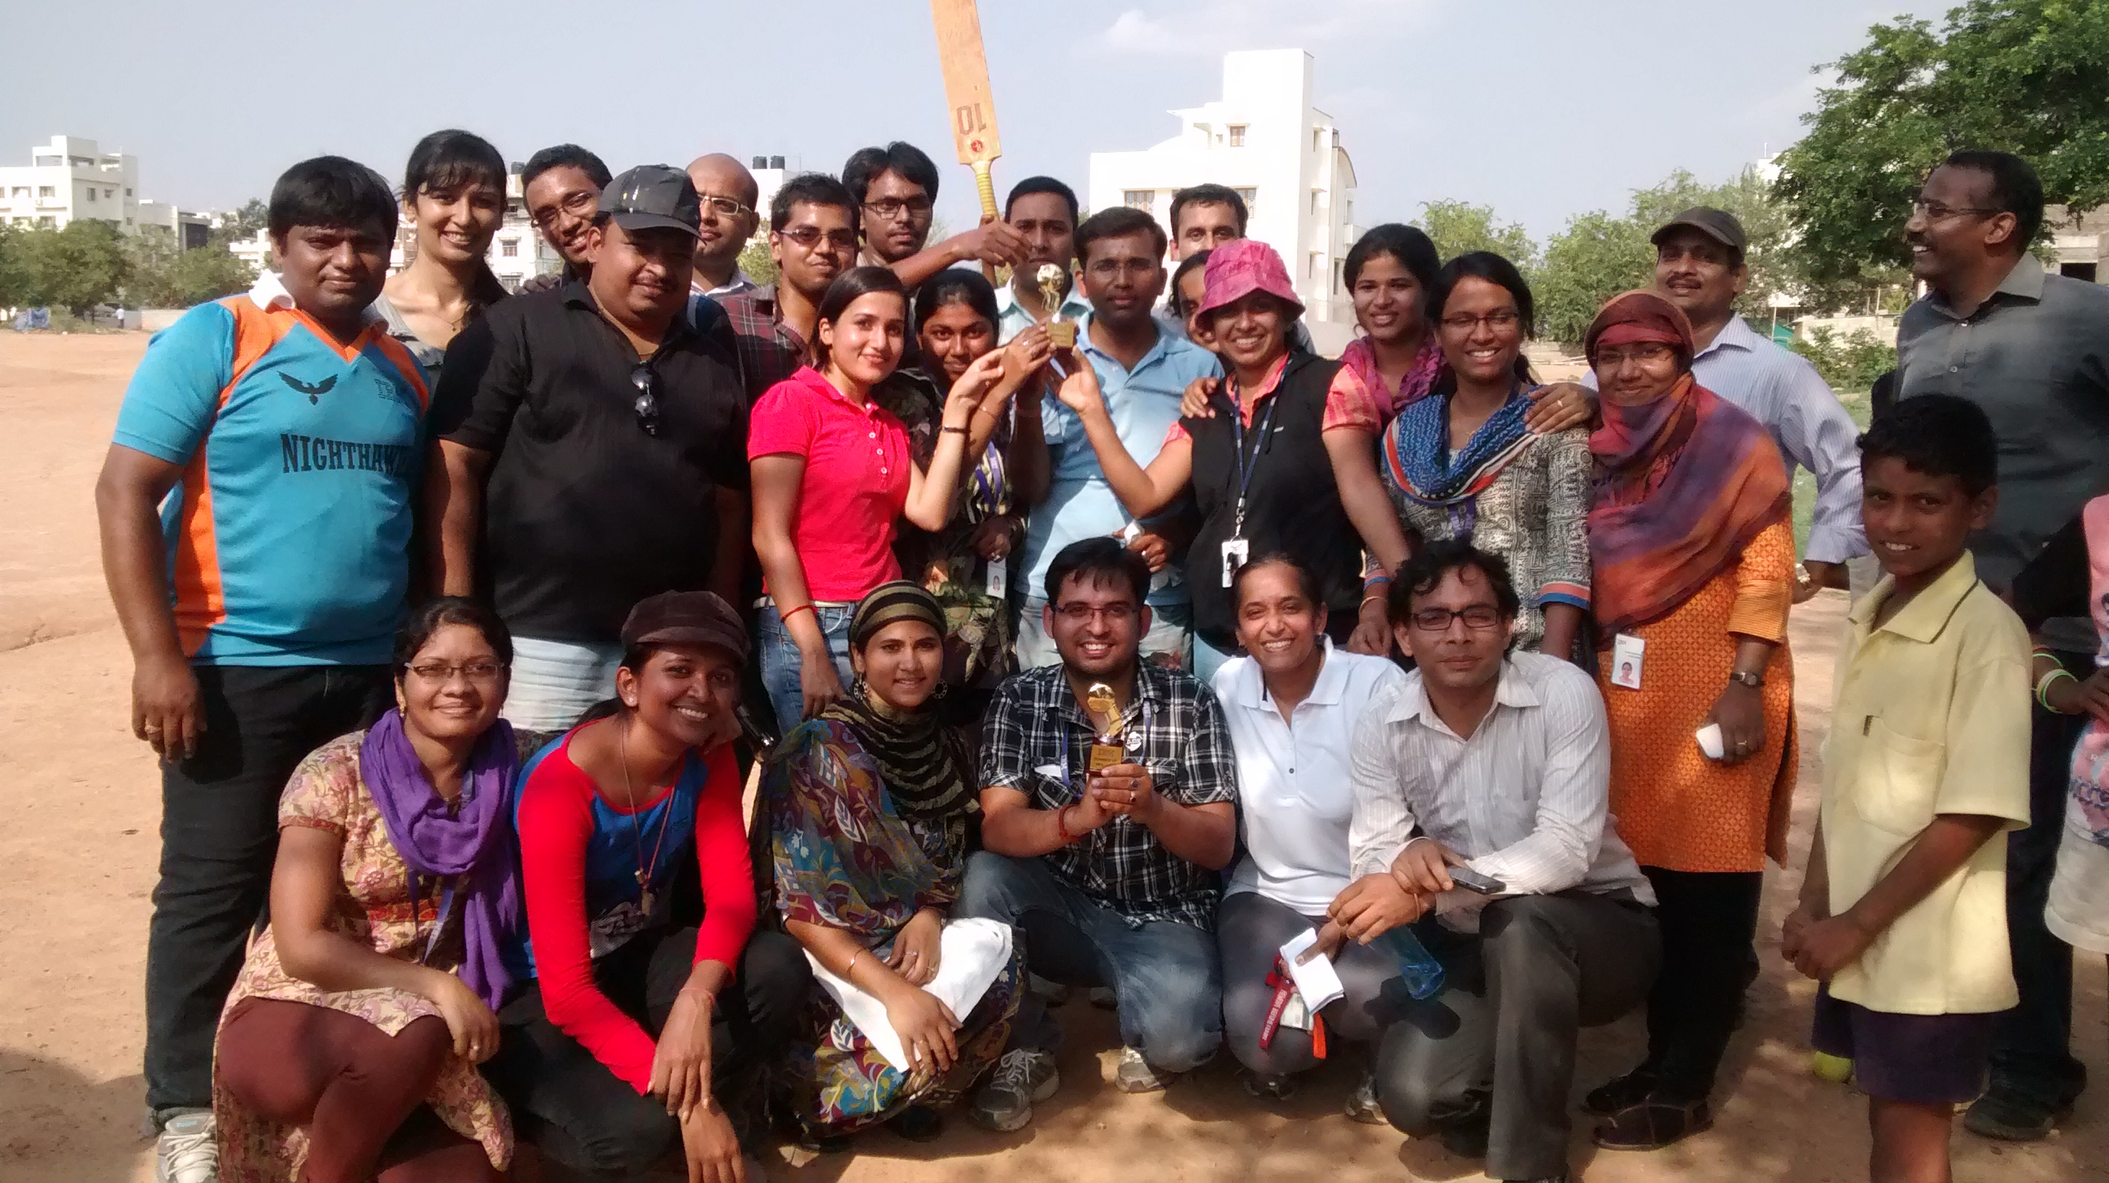
Once upon a time I was fond of Cricket

Slide 6
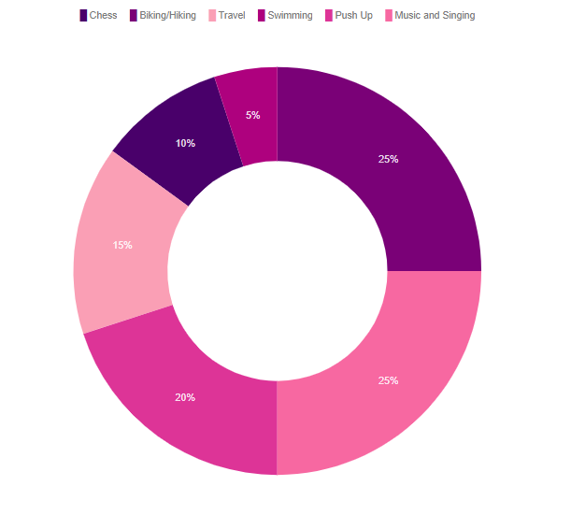






Hobbies/Intersting thing about me
Leechess 1900
18 miles/2 hr.
30 in one go/ 100 per day

Slide 7
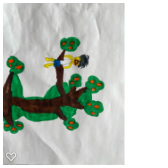
Childhood Hobby

Slide 8
Interesting Facts about me
I live with a Yogini and that’s my wife and she is my childhood friend
I am fond of Mathematics since my school days

Slide 9
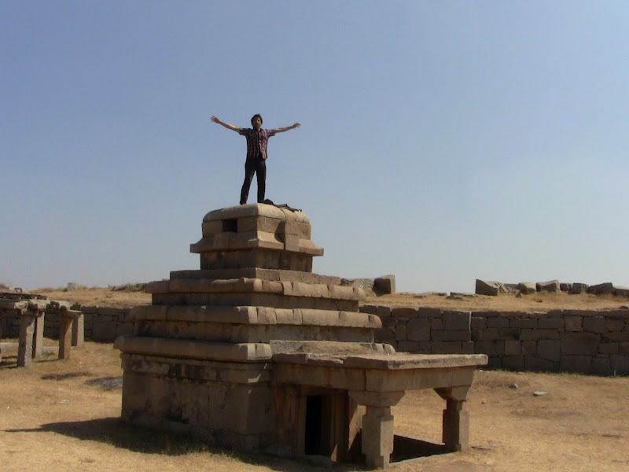
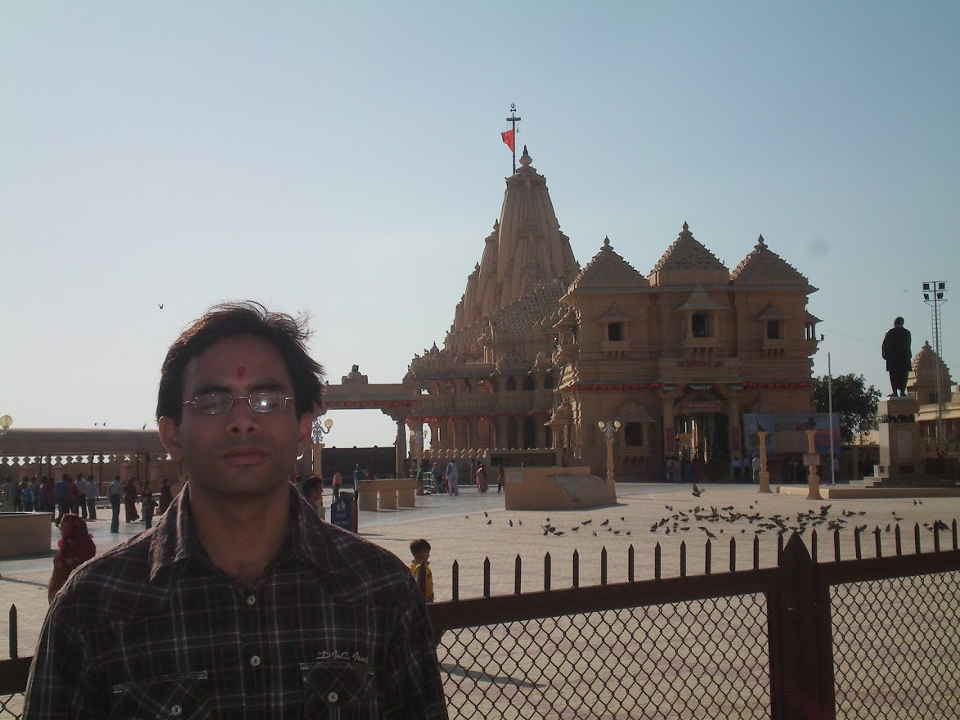
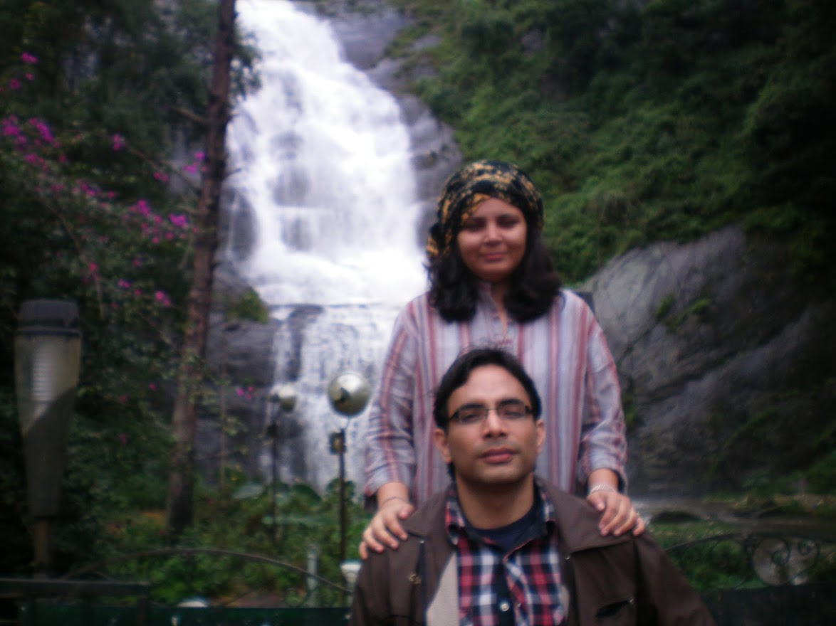
Known places in India
Hampi
Somnath
Kodaikanal

Slide 10
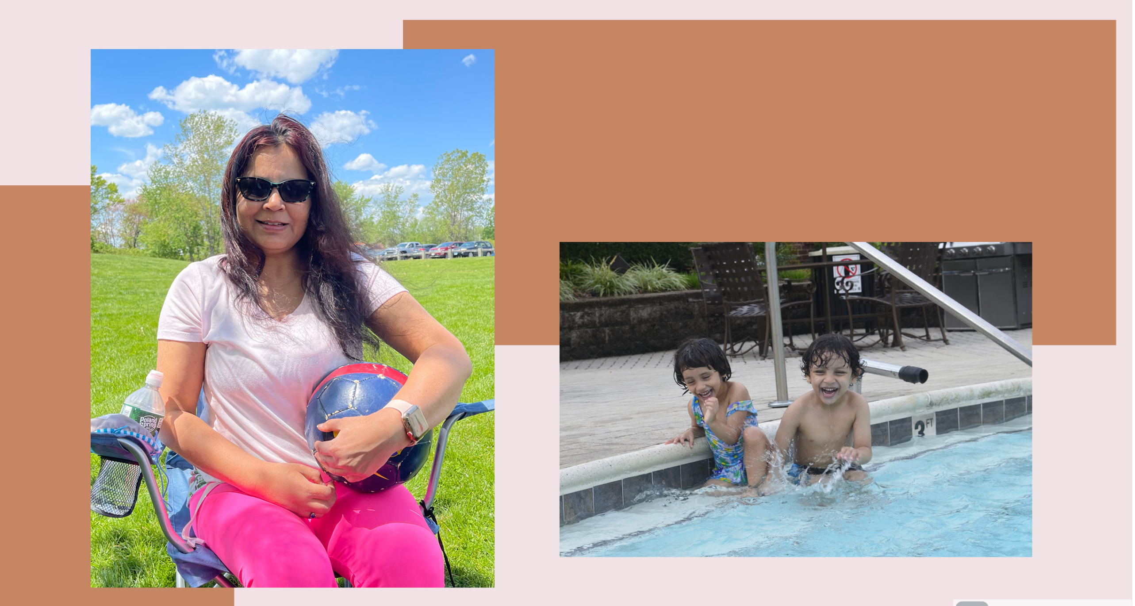
Family

Slide 11
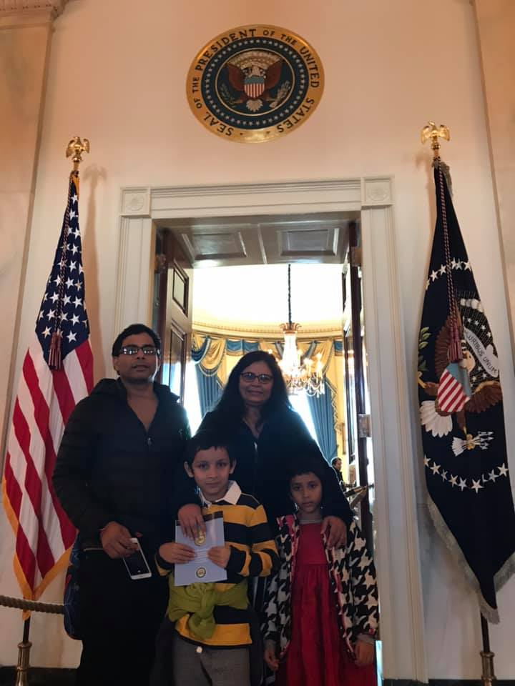
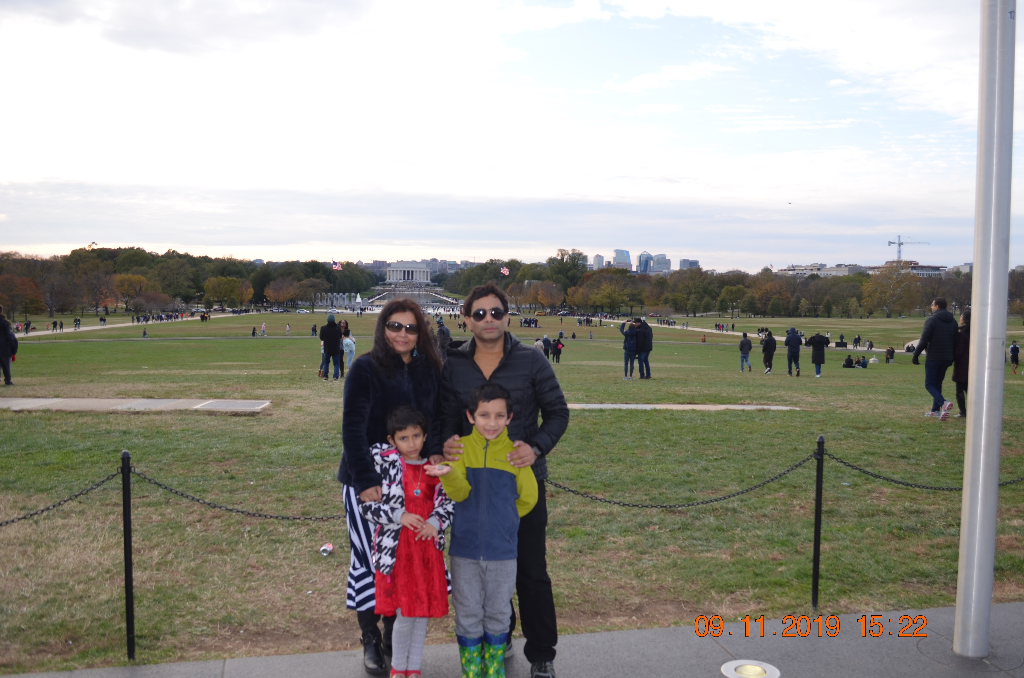
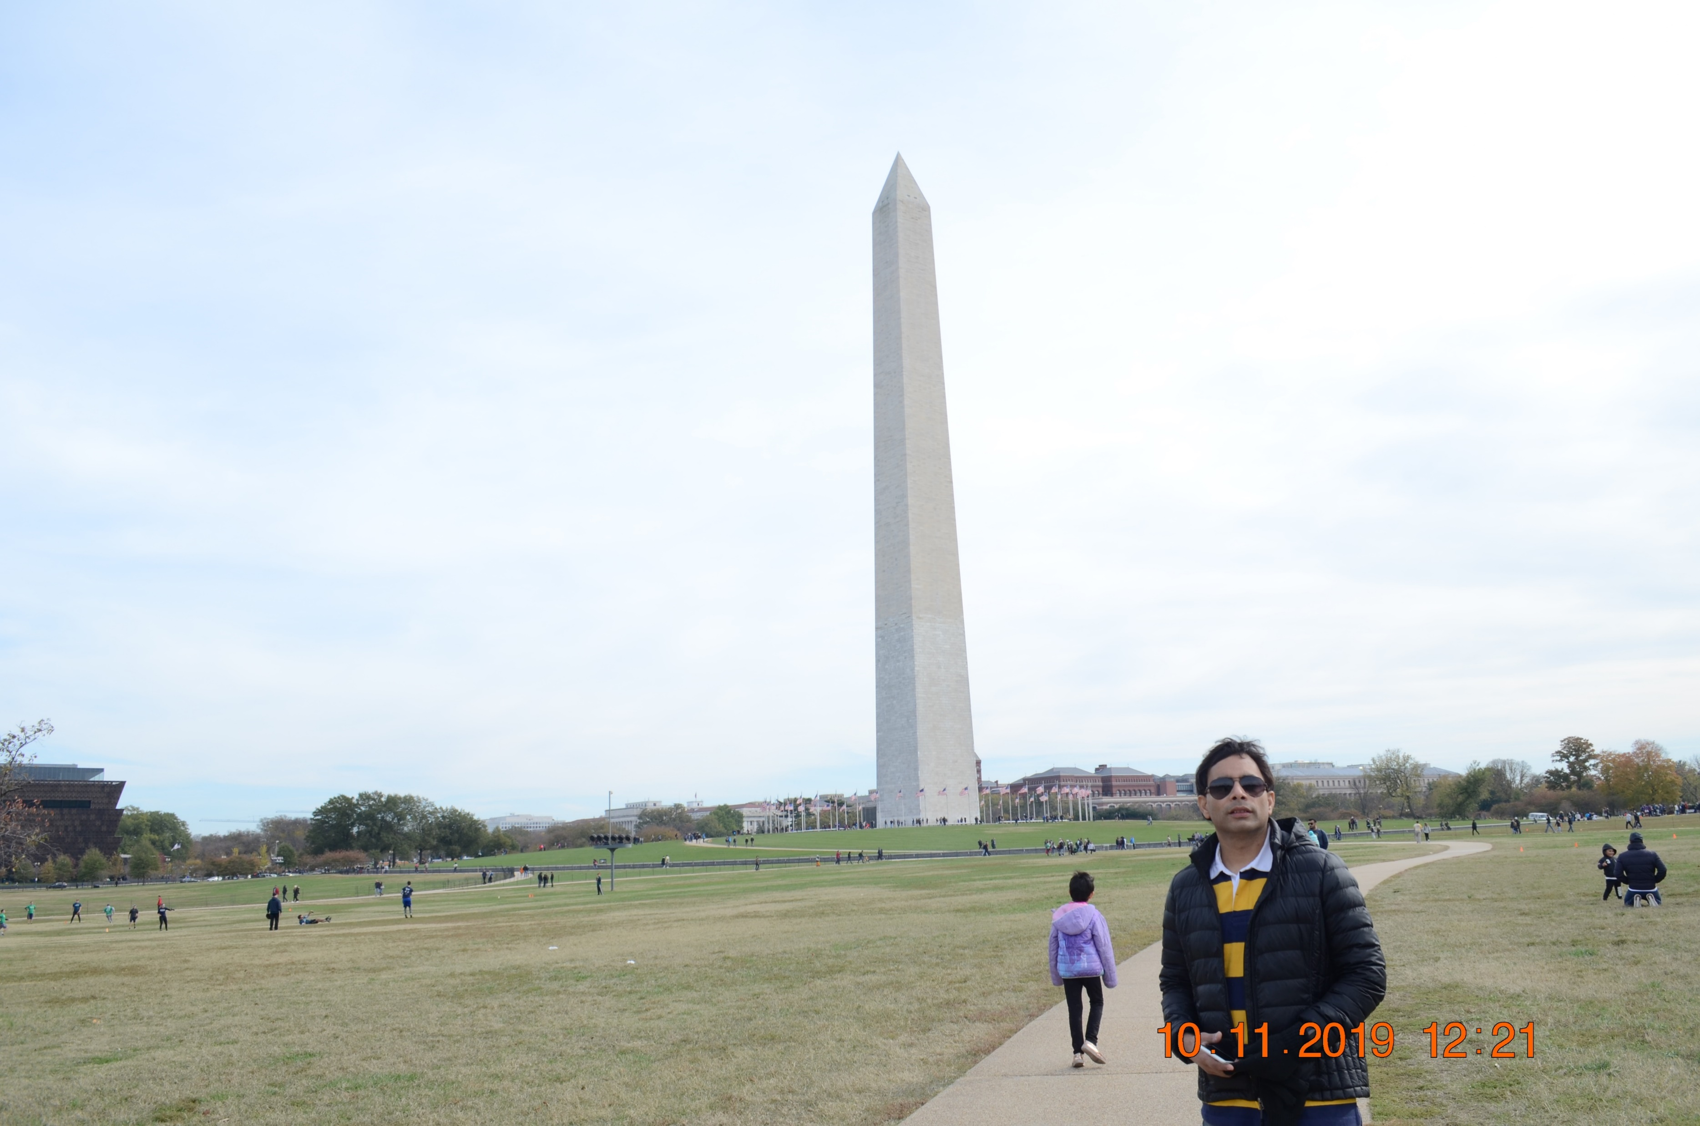
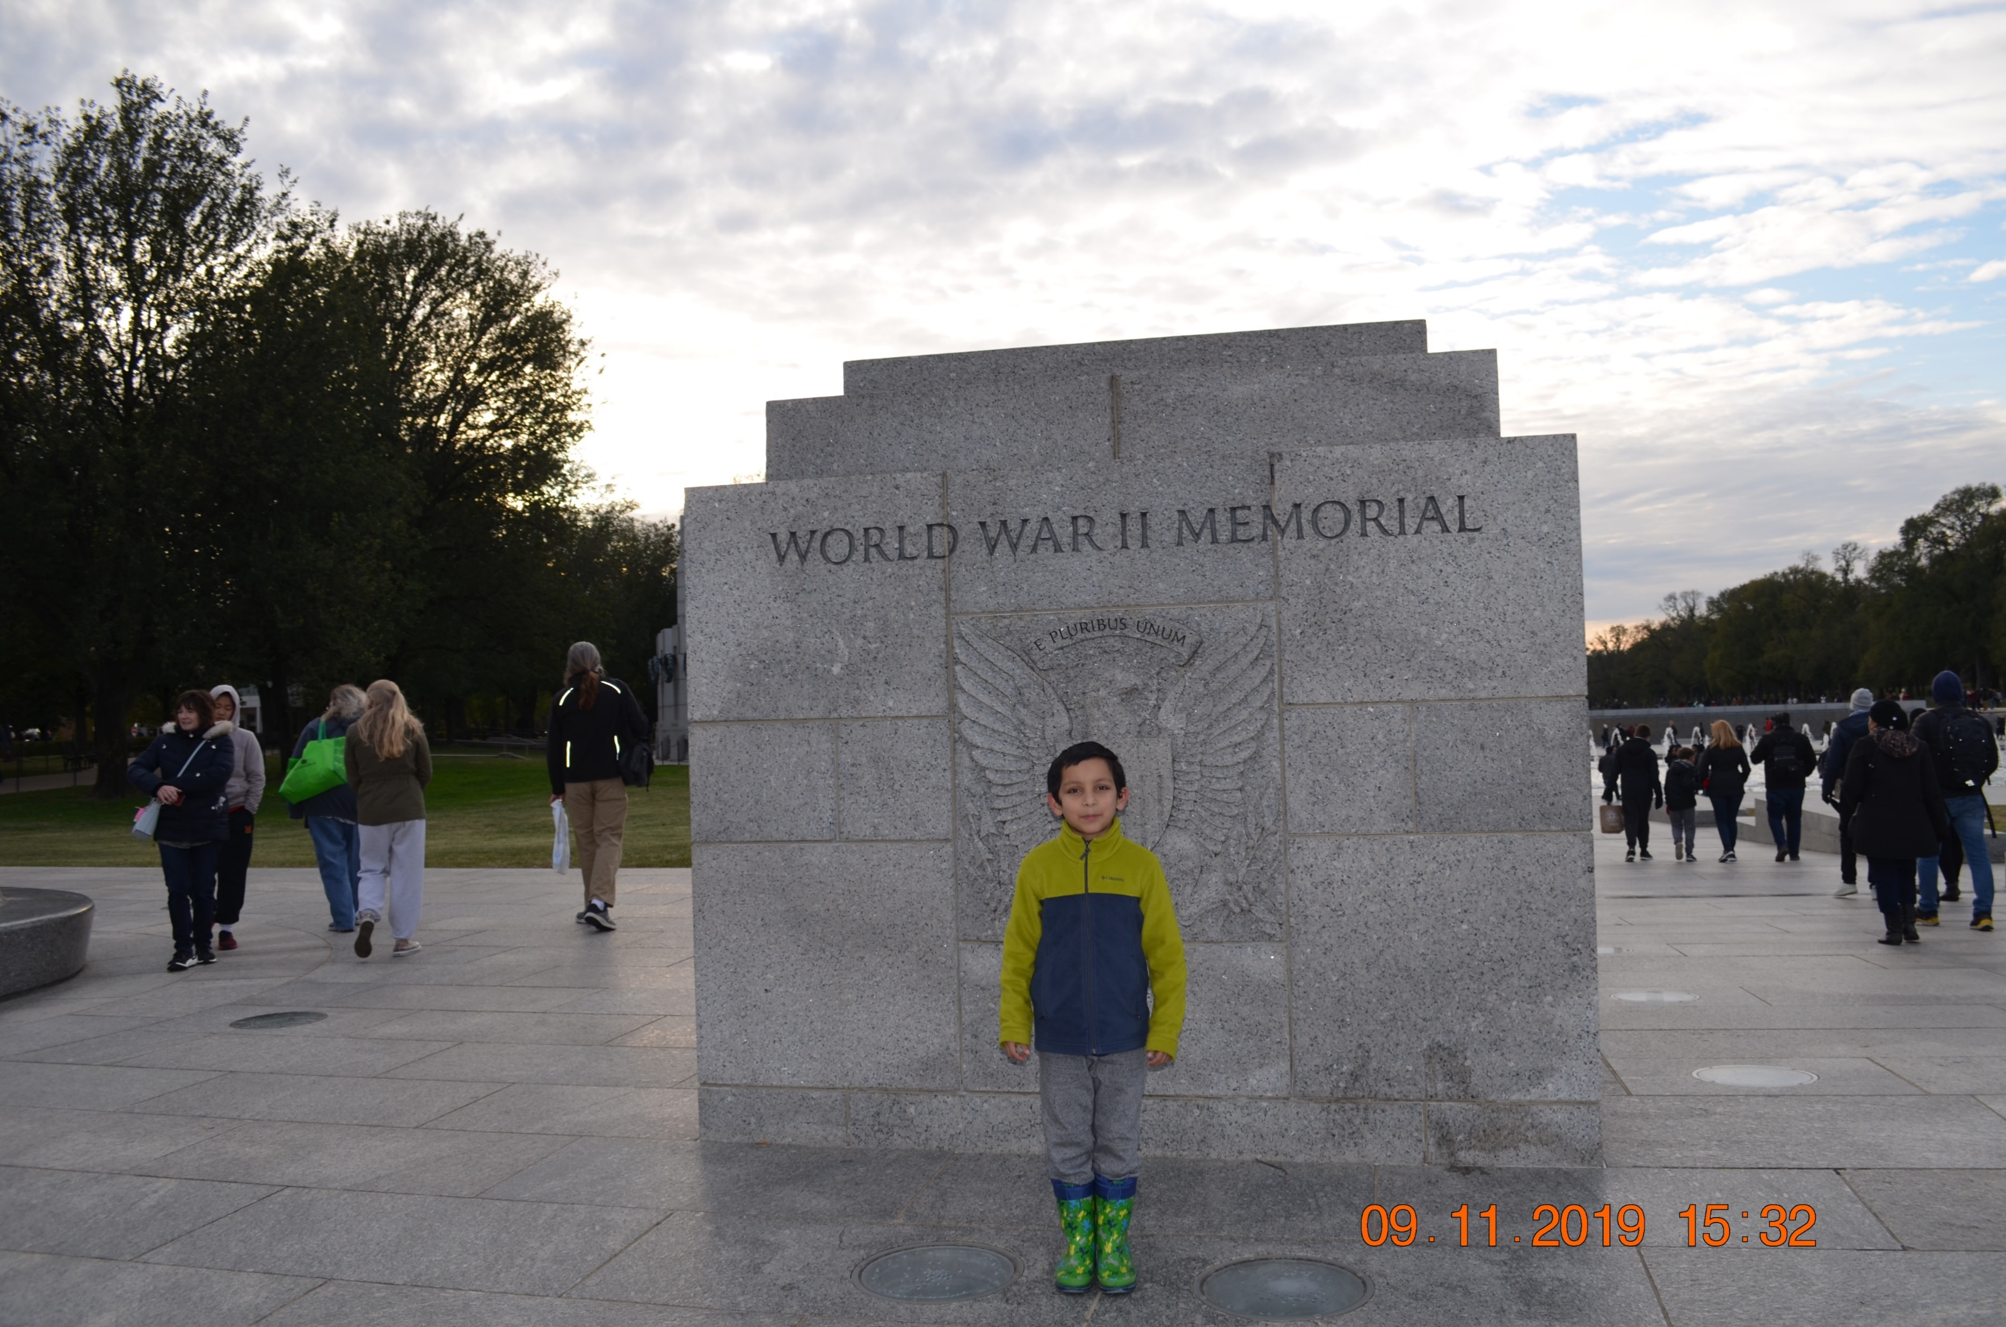
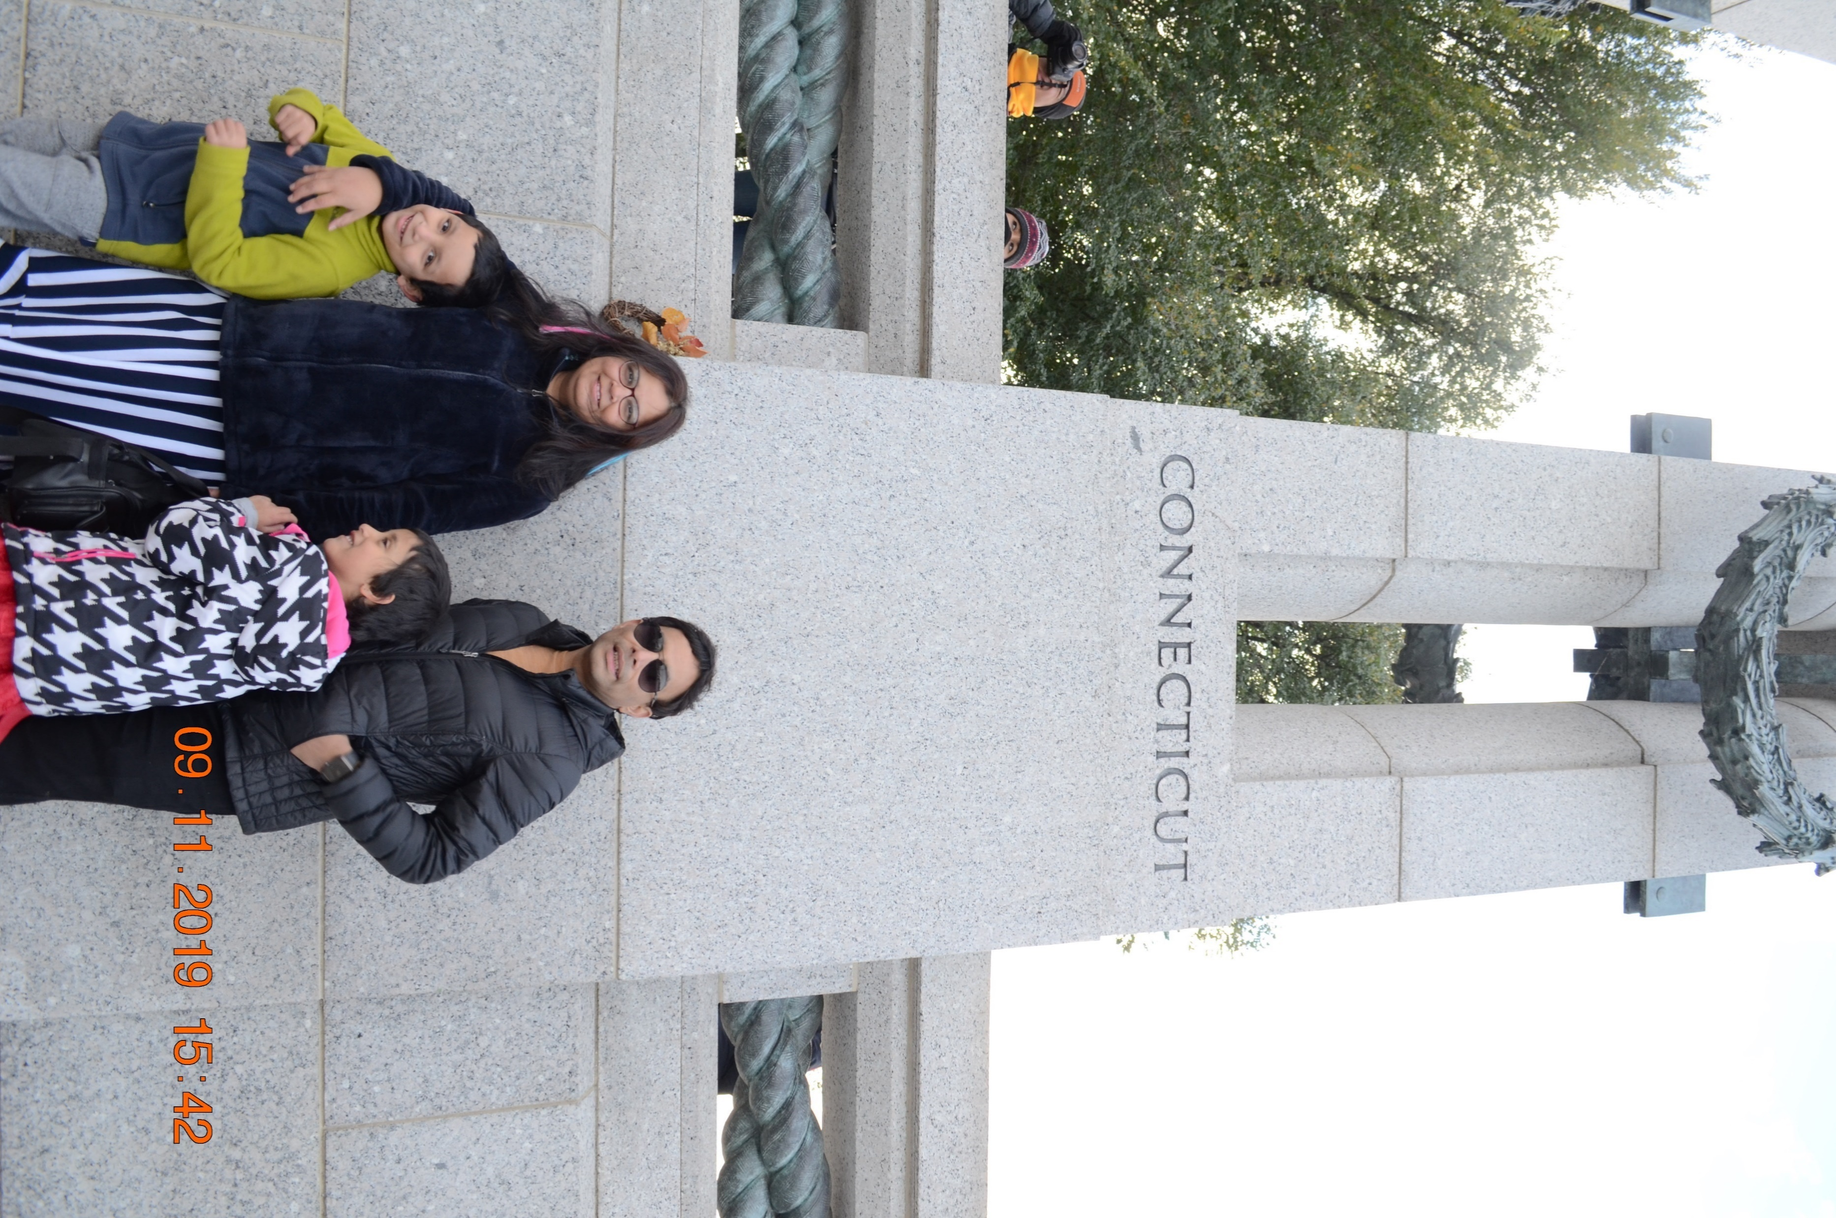
Memorable Trip
White House

Slide 12
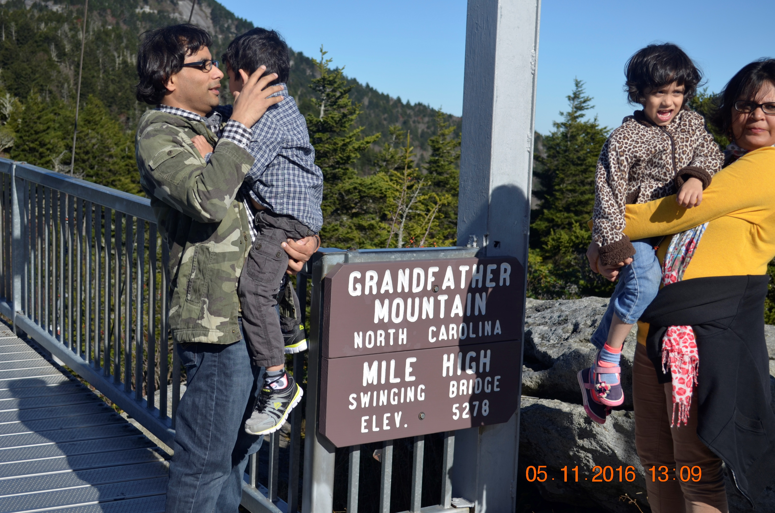
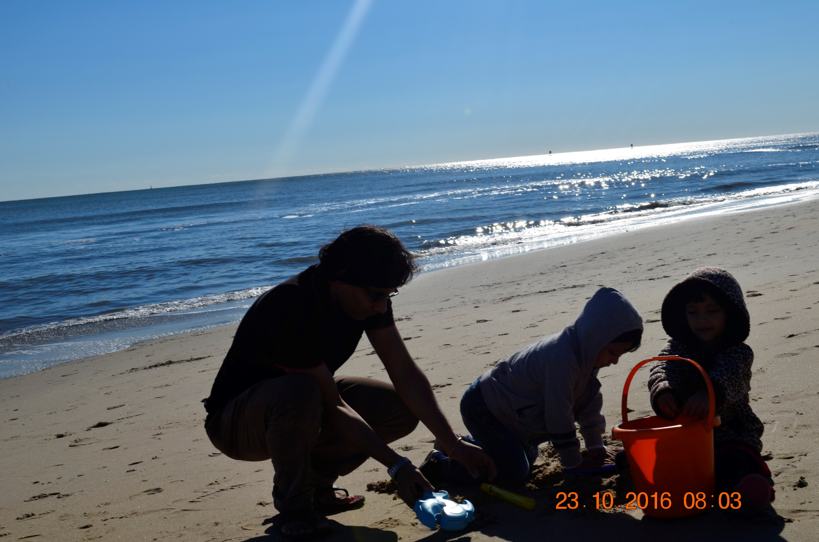
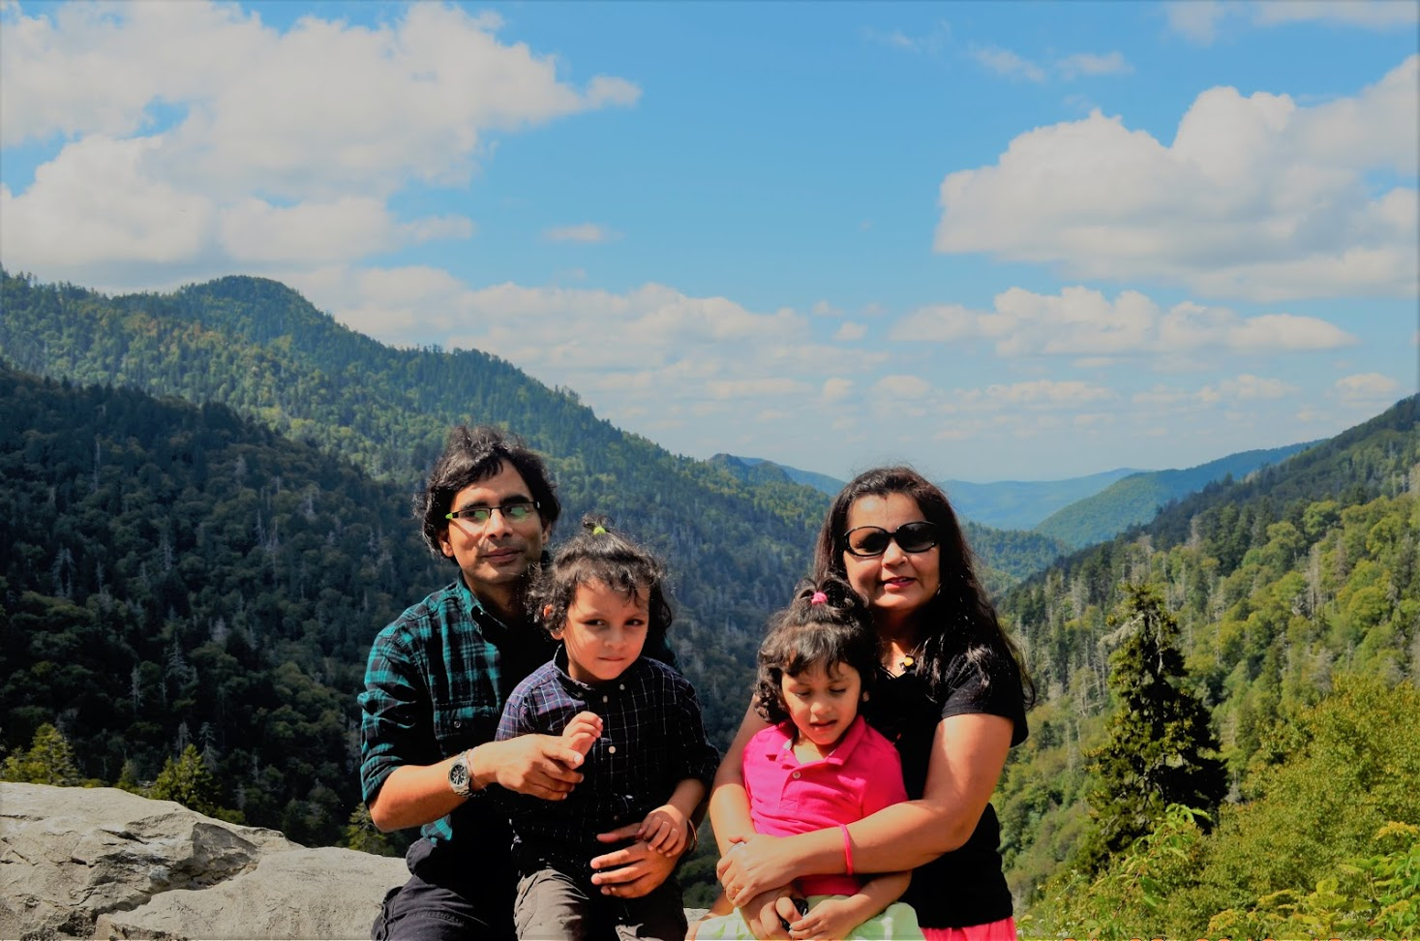
Mountains and Beach
Virginia Beach
Great Smoky

